Slide 1


Inrush Current Analysis
Electric Power Load Analysis (EPLA)
Revision of 12 July 2026
Dr. Norbert Doerry
http://doerry.org/norbert/MarineElectricalPowerSystems/index.htm
© 2026 by Norbert Doerry
This work is licensed via: CC BY 4.0 (https://creativecommons.org/)

Slide 2
Essential Questions
What are the characteristics of inrush current for different types of equipment? | Understand
What are system implications of inrush current on ac systems powered by generators? Powered by transformers? | Understand
What are system implications of inrush current on systems powered by power electronic converters? | Understand
What can be done to mitigate the impact of in-rush current on system performance? | Understand
How is in-rush current analysis performed? | Apply

Slide 3
Introduction
Large inrush currents may occur when energizing loads
  Depends on the design of the loads
  Depends on what inrush current mitigation features have been incorporated.
  Can last from milliseconds to seconds (15 ms to 35 ms is typical)
Inrush currents interact with sources and power system impedances to cause voltage to transiently dip.
  Voltage transient should stay within voltage transient tolerance limits (typically within 20% of nominal system voltage)
  Excessive inrush current may cause other loads to experience a service interruption.
Circuit protection equipment (circuit breakers and fuses) should be selected and configured to not respond to inrush current.
If many loads experience inrush current at the same time, their impacts are additive and can quickly lead to the voltage transients exceeding limits.

Slide 4
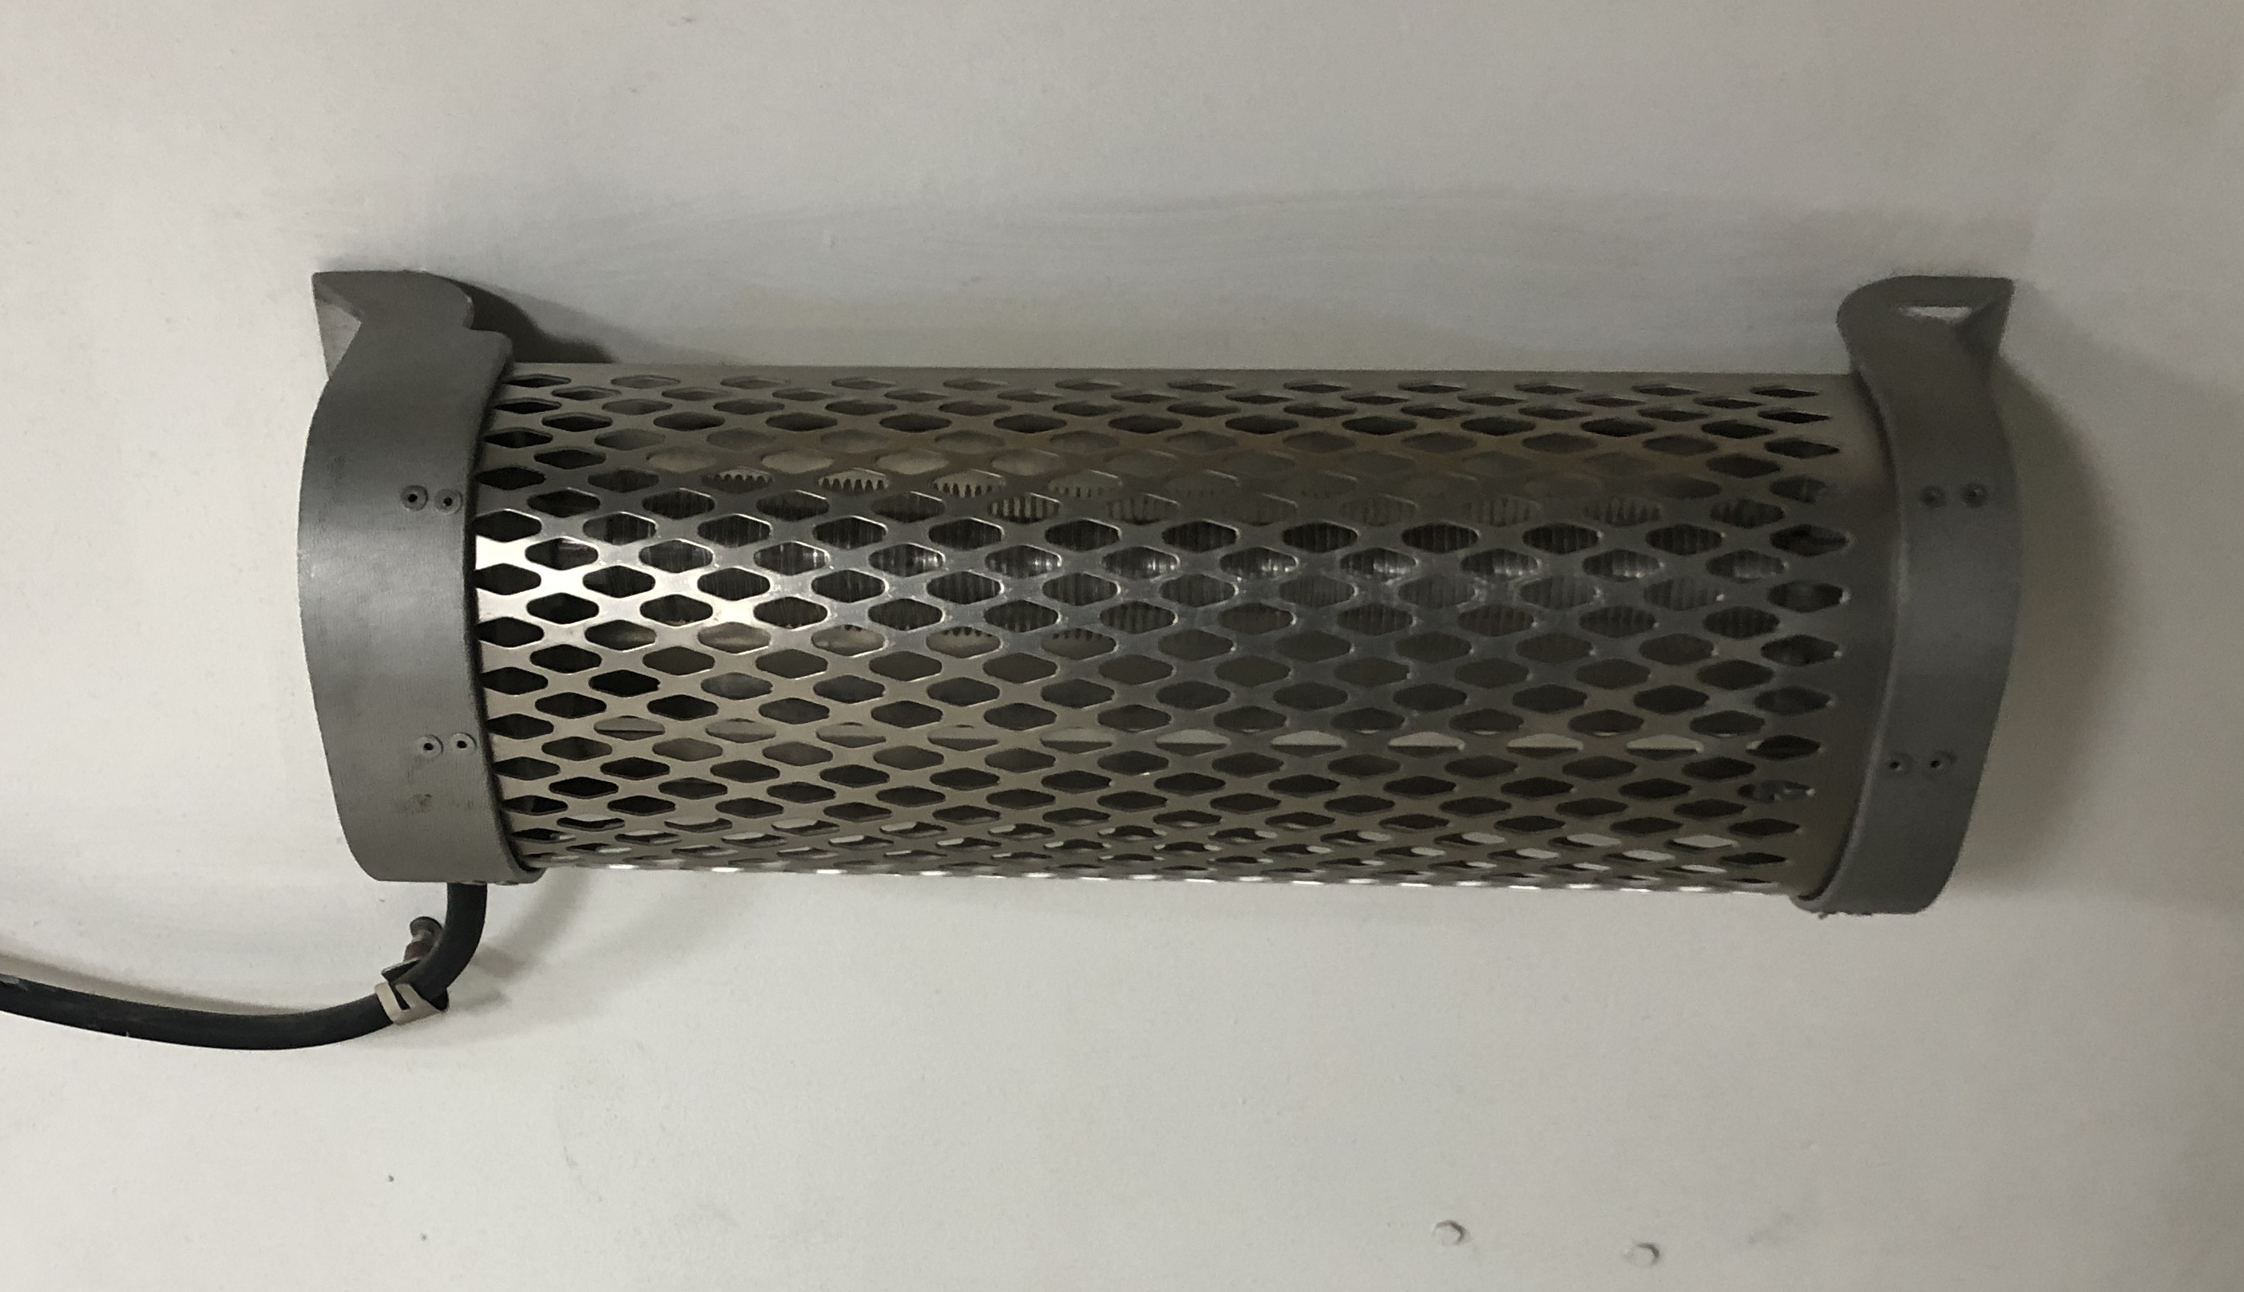
Inrush current: Resistive Loads
Inrush current usually only an issue if the temperature of the load changes significantly between the off state and the on state
  Resistance is usually a positive function of temperature
  Current draw when cold can be many times greater than when hot.
Typical equipment where inrush current is of concern
  Incandescent lights
  Electric Heaters
Electric Heater onboard BB-64
© 2023 by Norbert Doerry
Licensed via CC BY 4.0

Slide 5
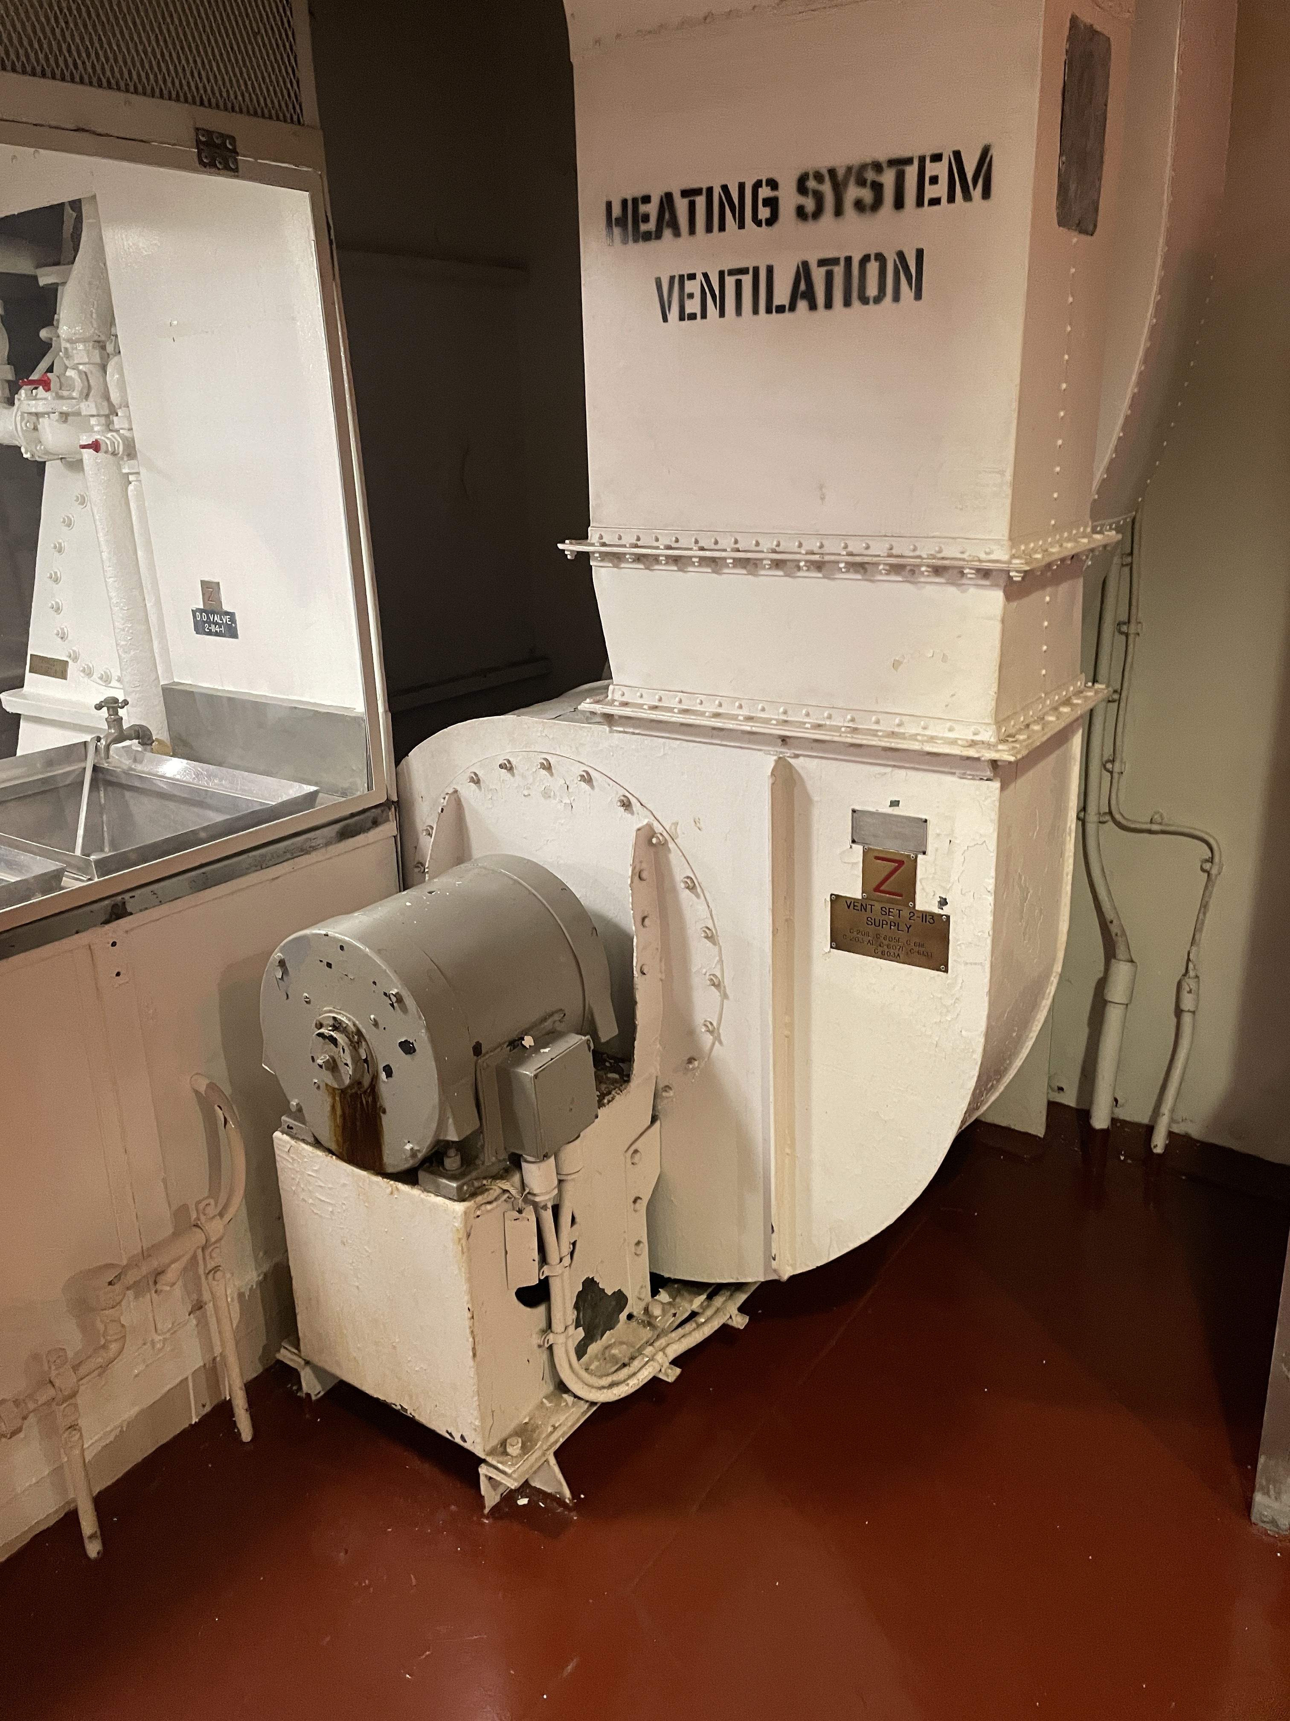
Inrush Current: Motors
Inrush current can be significant
  May be 5 to 10 times the full load amps
  Estimate peak with the Locked Rotor Amps (LRA)
    On the label plate
    Alternately, the label plate may have a code letter indicating range of kVA per horsepower (see NEC)
Motor controller Types
  Low Voltage Release (LVR): Automatic restart following a power disruption
  Low Voltage Protection (LVP): Must be manually (or remotely) restarted following a power disruption
Ventilation Fan Motor
© 2026by Norbert Doerry
Licensed via CC BY 4.0

Slide 6
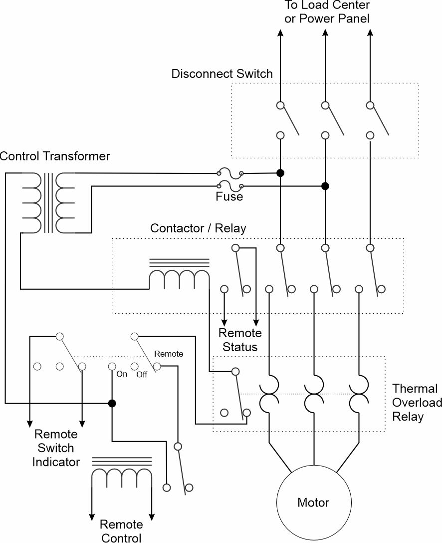
Low Voltage Release (LVR) motor controller
Disconnect Switch
  Enables maintenance on motor and rest of motor controller
Contactor Relay
  Allows for low voltage to control turning the motor on or off
Thermal Overload Relay
  Turns the motor on if the current is too big for two long
Control transformer
  Provides low voltage control power
On-Off-Remote Switch
  Controls whether the motor is on, off or controlled remotely
Motor automatically restarts following a power disruption

Slide 7
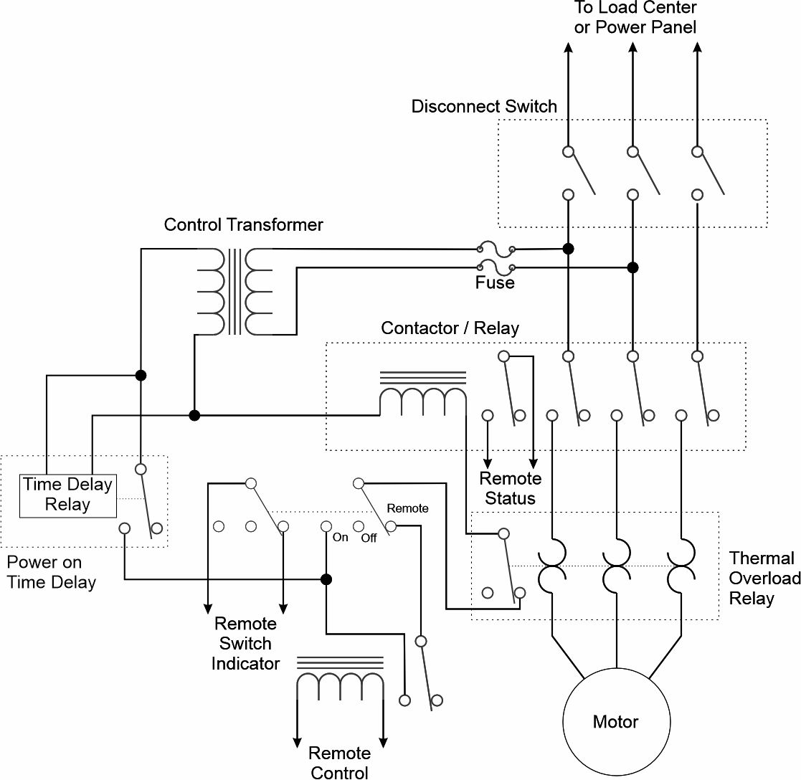
LVR with time delay relay
Time Delay Relay used to delay starting the motor for a short time after power is restored
  Typically 50 ms to several seconds.
Spreads out the inrush current over time to reduce the peak inrush current experienced by sources.

Slide 8
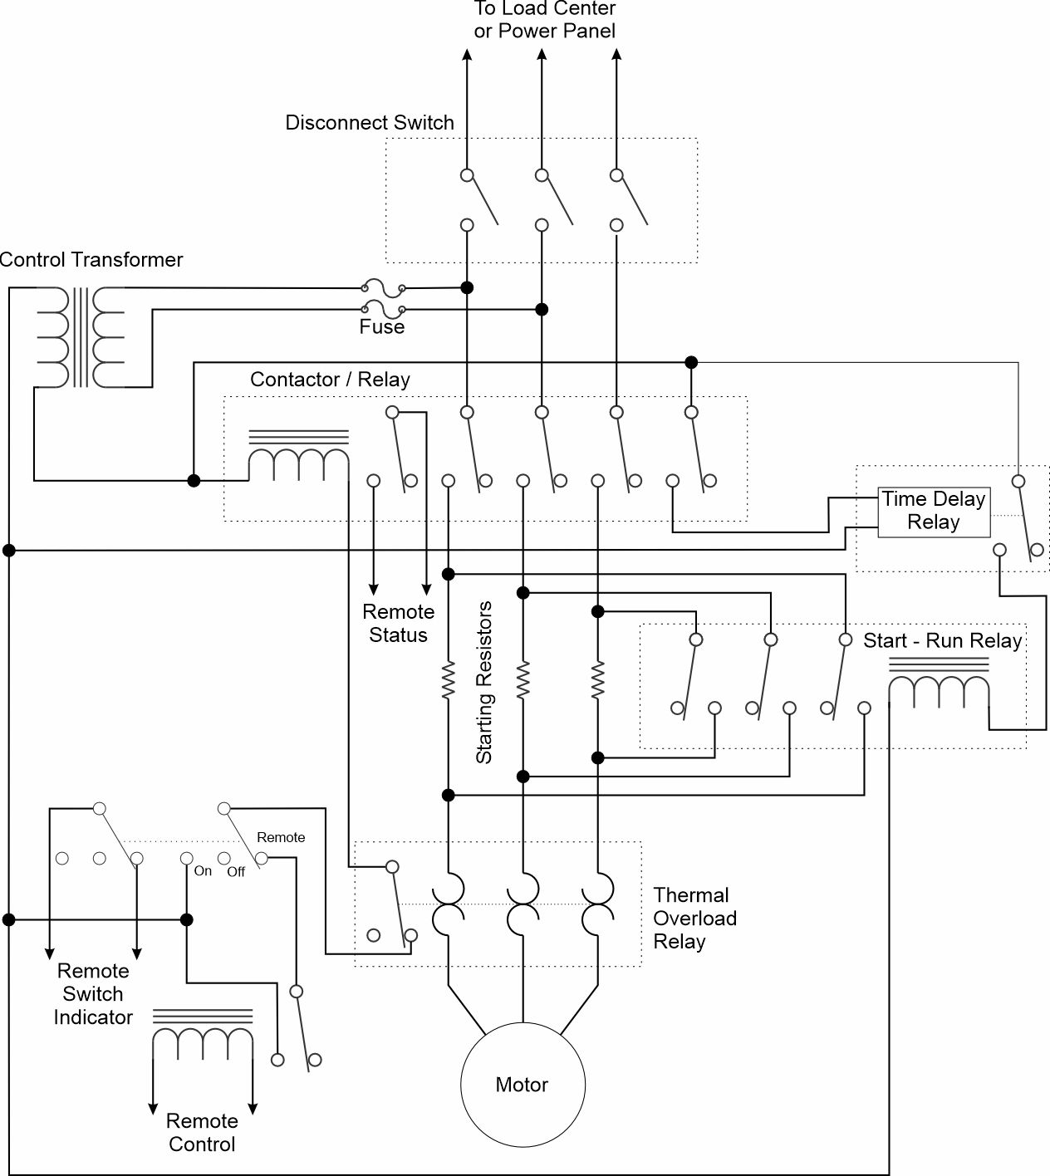
LVR with starting resistors
Starting resistors limit the inrush current when the motor starts
Starting resistors shorted out after the initial inrush current
  Fixed time based on time delay relay (shown)
  Minimum speed attained based on speed sensor

Slide 9
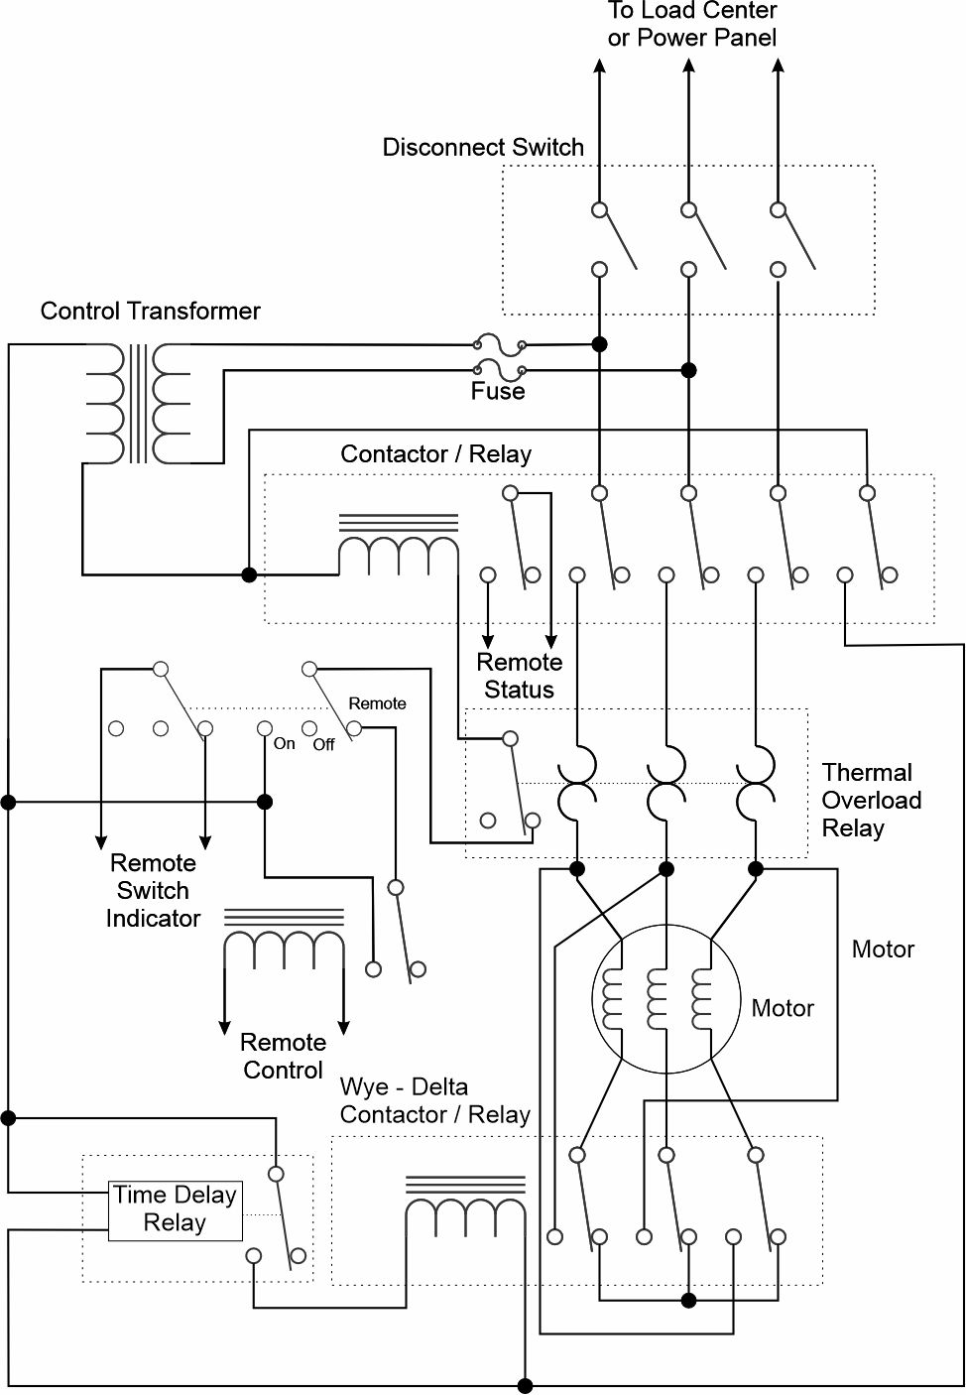
LVR with wye-delta Starting
Wye-delta starting reduces the voltage on the motor windings when starting (wye) before switching to the run configuration (delta)
Winding configuration switched from wye to delta after the initial inrush current
  Fixed time based on time delay relay (shown)
  Minimum speed attained based on speed sensor

Slide 10
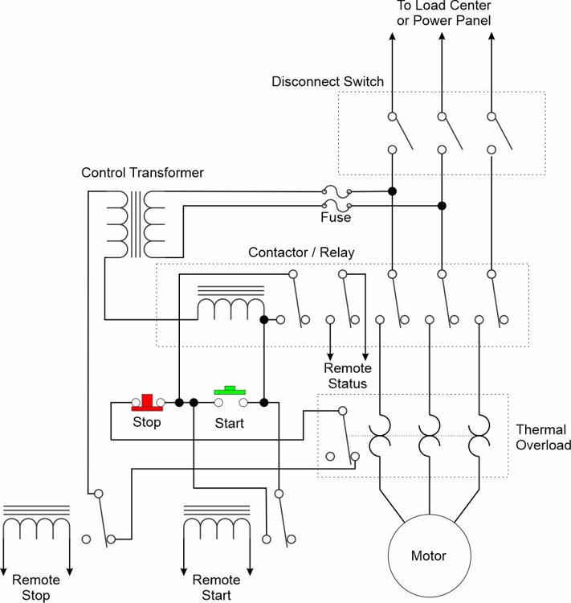
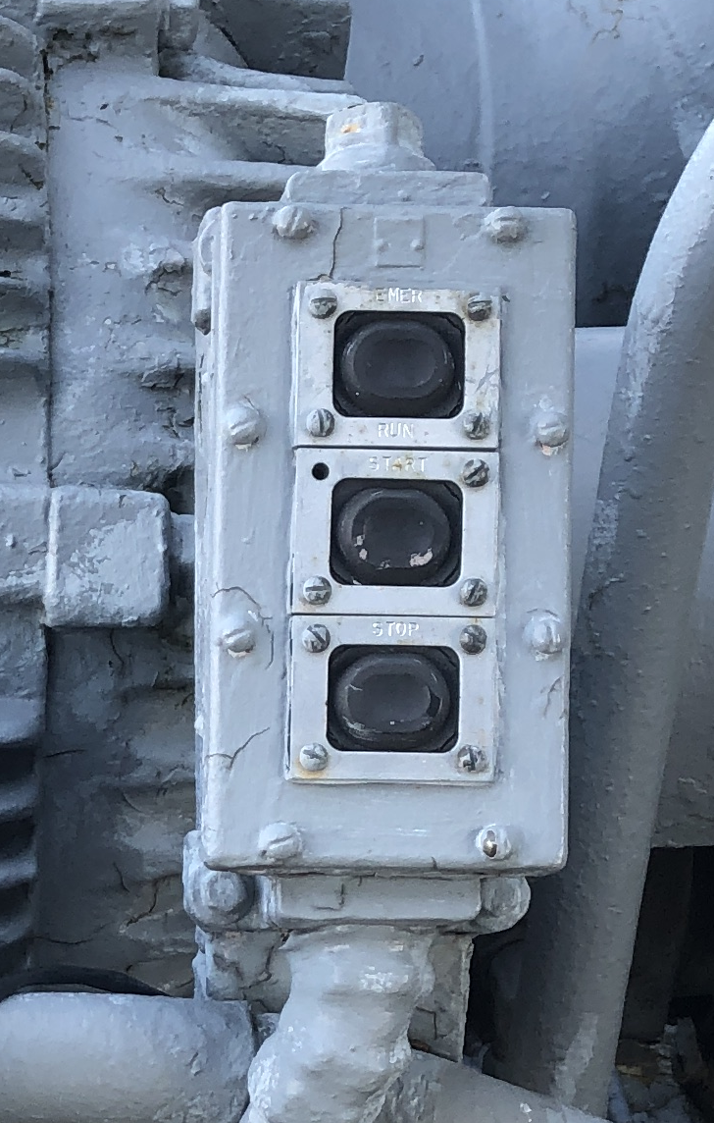
Low Voltage Protection motor controller
Start button energizes the contactor / relay
Contacts on the contactor / relay short out the start button to keep the motor powered when the start button is released.
  Remote start signal can also start the motor
Motor turns off when:
  Stop button pressed
  Power is lost
  Thermal overload trips
  Remote stop signal is received
LVP controller onboard BB-64
© 2023 by Norbert Doerry
Licensed via CC BY 4.0

Slide 11
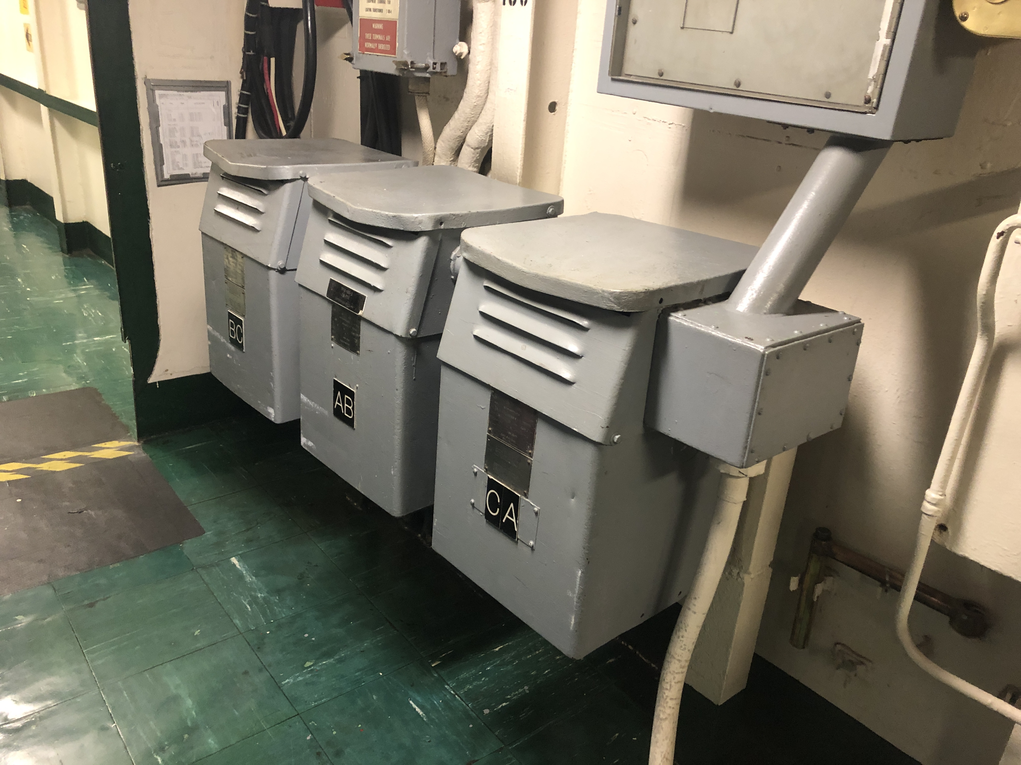
Inrush Current: Transformers
When a transformer is initially energized, inrush current may be between 5 and 12 times the rated current
  During first half cycle, the flux may achieve twice its steady-state value resulting in core saturating
  Core saturation leads to high inrush current
Inrush current can be managed by
  Pre-magnetization circuits
  Starting resistors
Medium voltage (> 1 kV) to low voltage (< 1 kV) transformers almost always require some method of reducing inrush current
Transformer bank onboard CV-41
© 2024 by Norbert Doerry
Licensed via CC BY 4.0

Slide 12
Inrush Current: Capacitive filters
Without mitigation, the inrush current into an input filter capacitor is often limited by just the internal resistance of the capacitor
Large electronic equipment typically employ a method to “soft” charge the capacitor slowly to avoid a large inrush current.
Consult equipment data sheets to determine the inrush current.

Slide 13
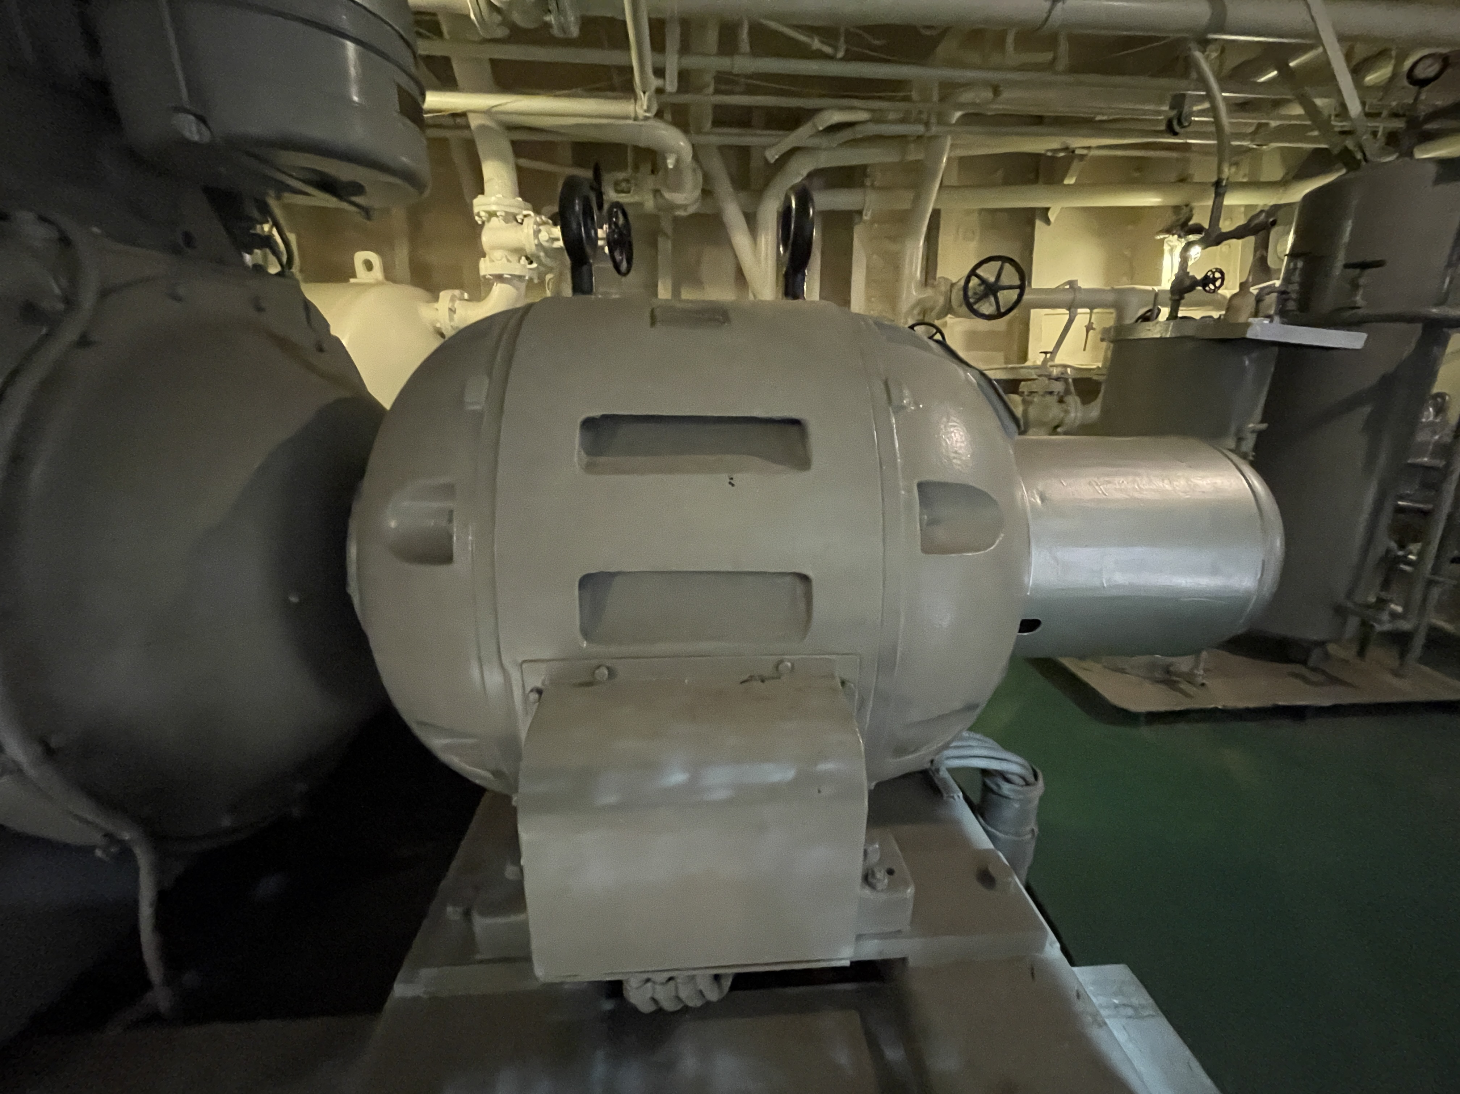
Impact of Inrush current on Generators
Reaction time of voltage regulator to a disturbance limited by the field current time constant (typically on order of seconds)
Inrush current results in voltage drop at the generator terminals
  In-rush current times the sub-transient reactance
Inrush current capability limited by the transient voltage tolerance (~20%)
  Typically can only support an inrush current of between 1.4 to 2.5 times the rated current.
Col. James M. Schoonmaker Diesel Generator
© 2026 Norbert Doerry
Licensed CC BY 4.0

Slide 14
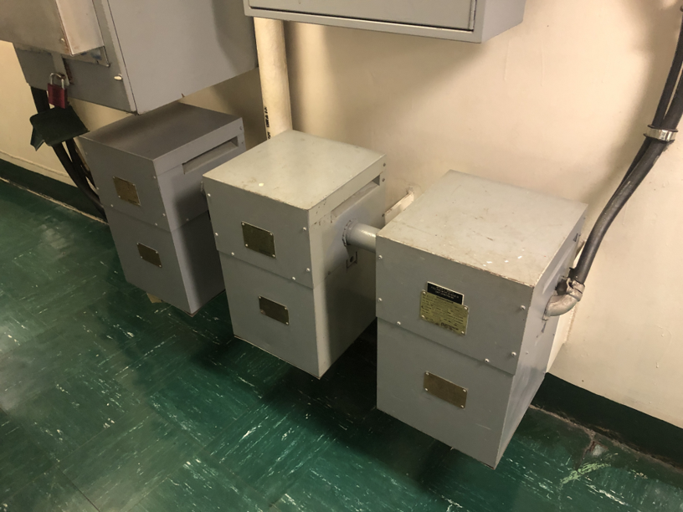
Impact of Inrush current on Transformers
Voltage dip at the secondary terminals due to supplying inrush current function of
  Voltage dip on the primary
  Transformer impedance
Transformer impedance should be calculated at the voltage transient frequency (usually around 1 kHz)
Inrush current supplying capability could be as low as 20% of the full load current.
Transformer bank onboard CV-41
© 2024 by Norbert Doerry
Licensed via CC BY 4.0

Slide 15
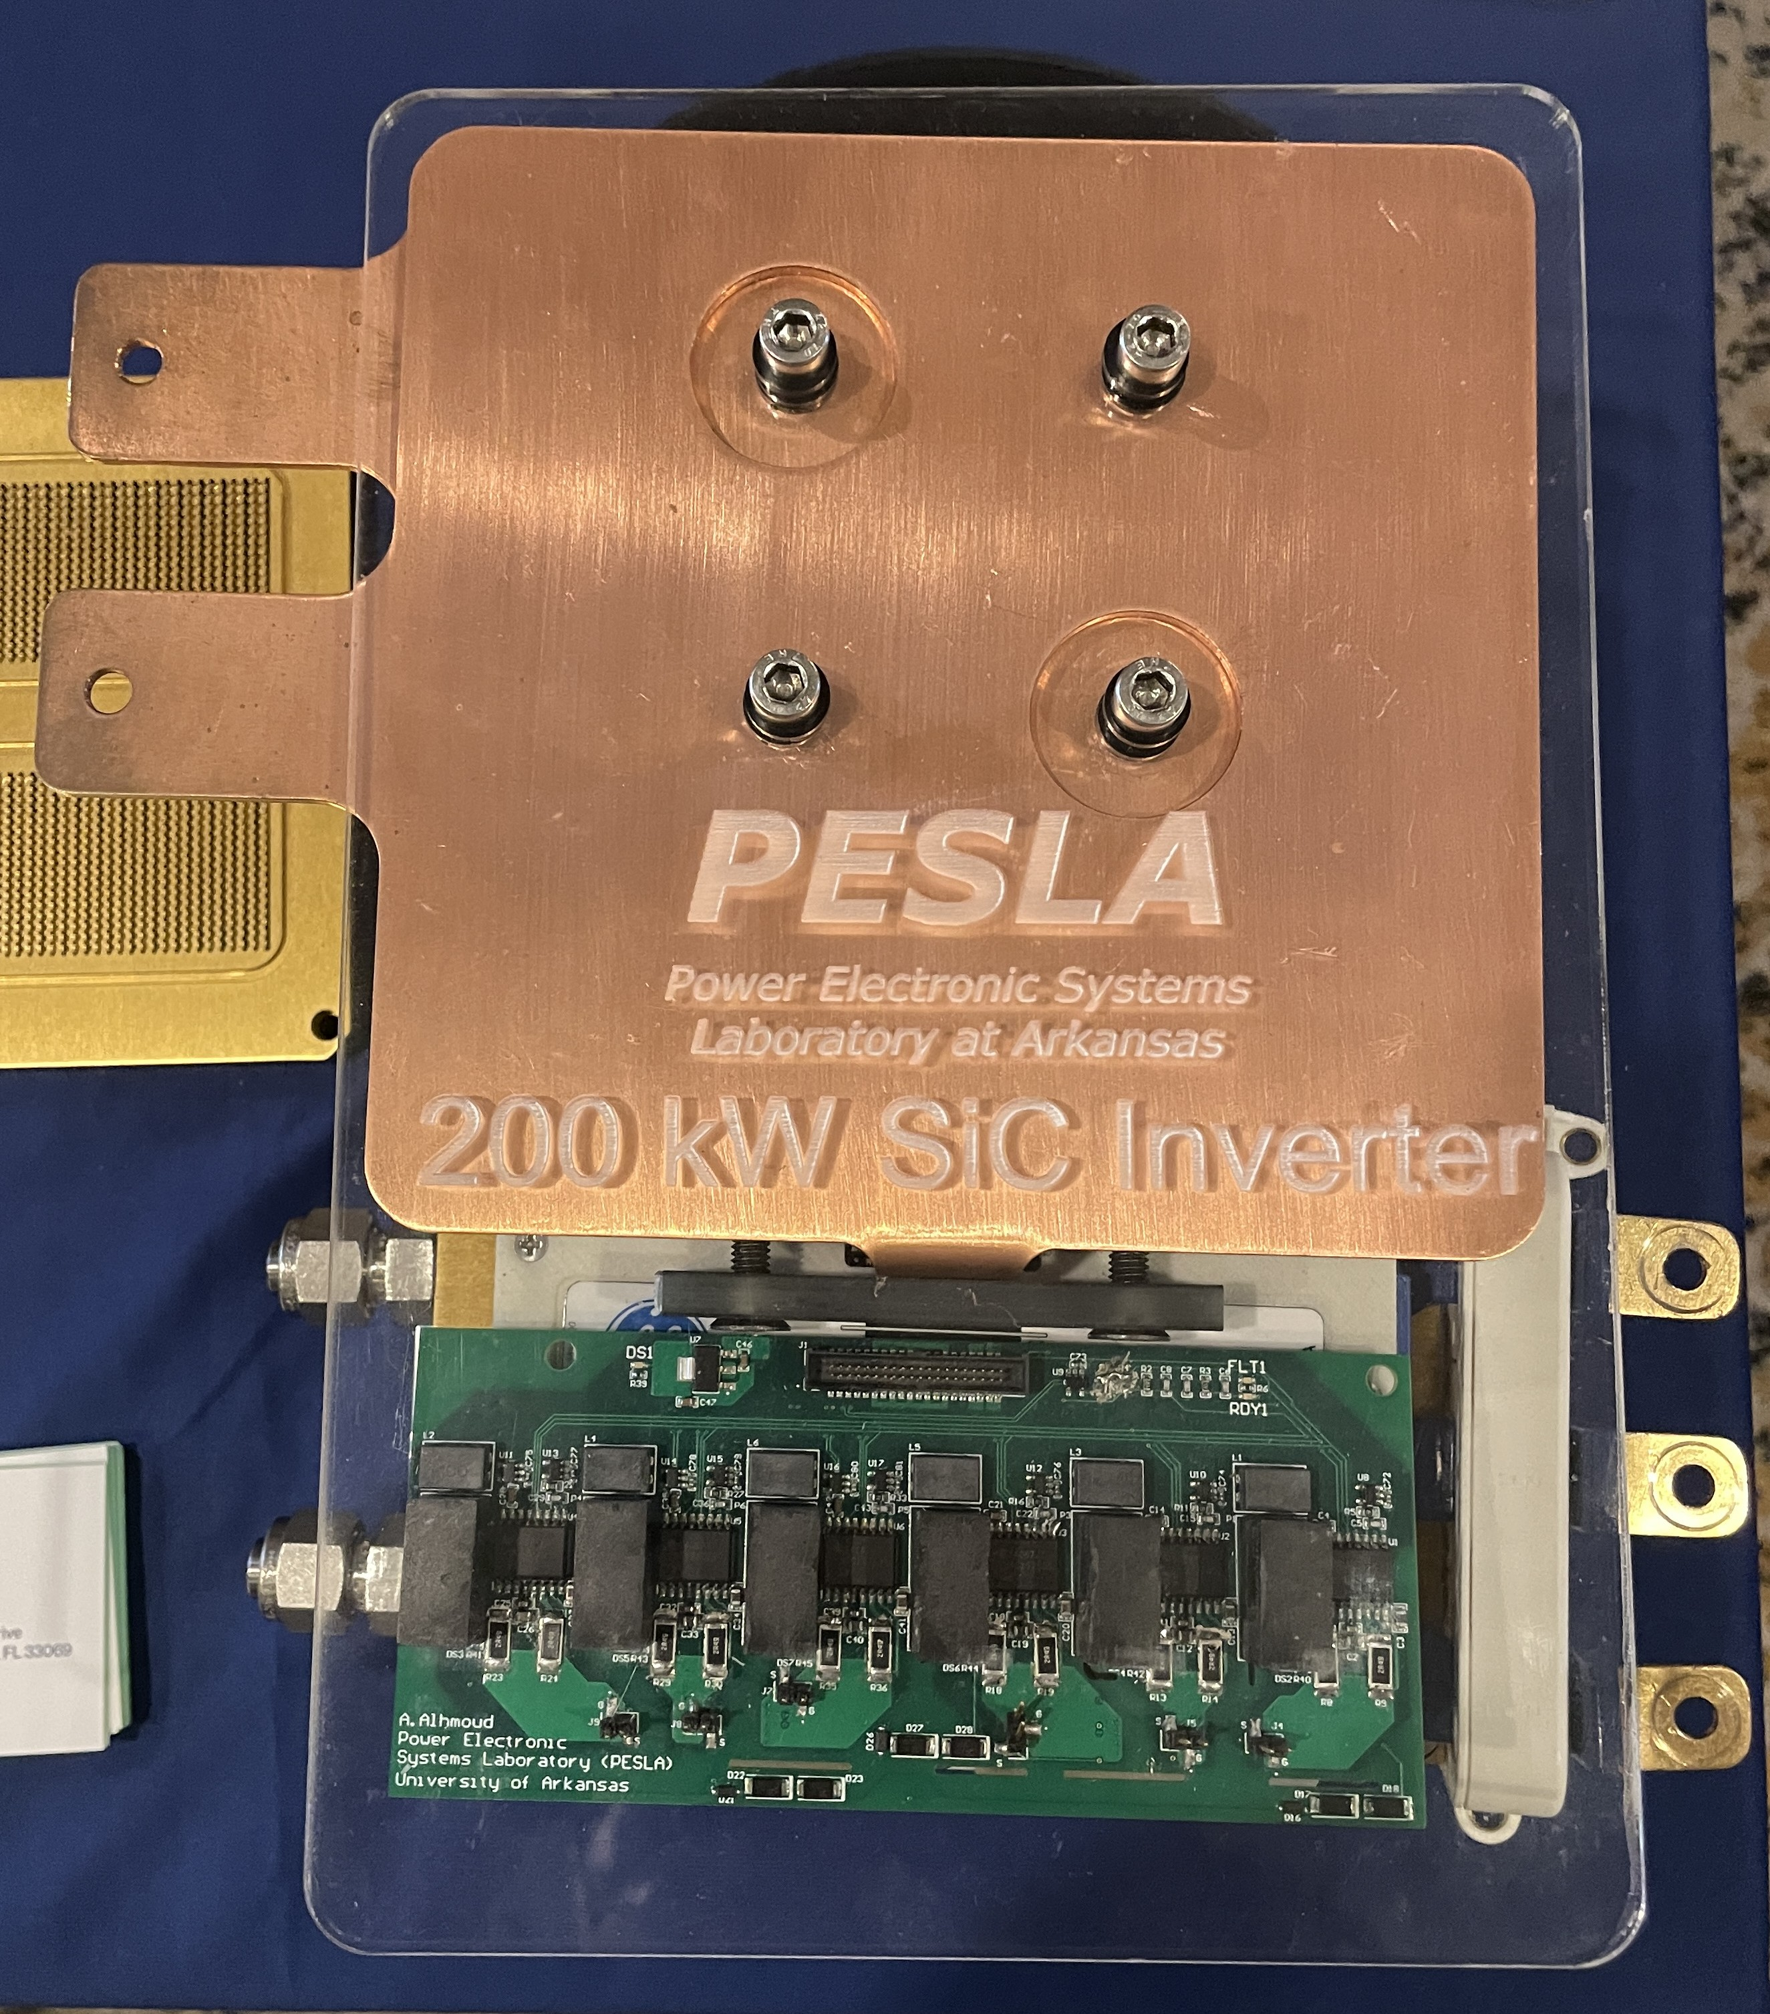
Impact of Inrush current on Power Electronics
Inrush current capability a function of
  Thermal limits of the semiconductors
  Amount of energy stored in the dc link
Manufacturer’s data sheets should be consulted.
A typical inverter may supply inrush current on the order of the rated current for a maximum of 3 seconds.
  If magnitude or duration is exceeded inverter may self-protect and shut down.
© 2025 by Norbert Doerry
Licensed via CC BY 4.0

Slide 16
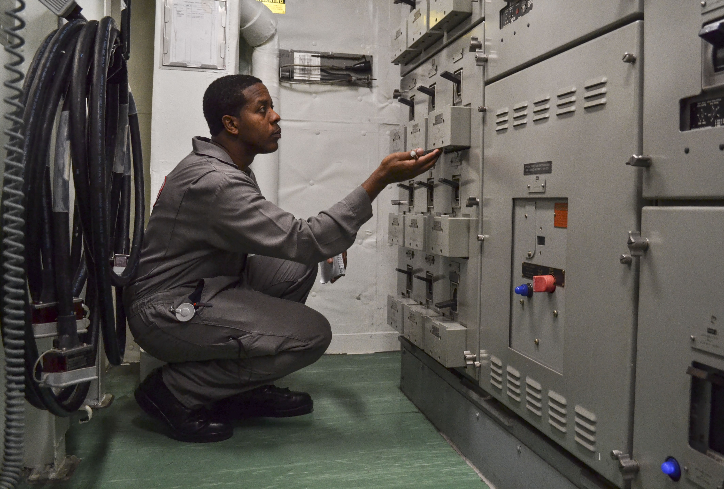
Impact of Inrush current on Switchboards, Load Centers and Power Panels
Voltage transient at a switchboard load center or power panel a function of:
  Voltage drops due to the generator / power electronic converter and power transformers (if applicable)
  Voltage drop in the feeder cables to the load centers and power panels
Feeder cable voltage drop calculated based on cable impedance and fault current magnitude
  Feeder cable impedance should be calculated at the voltage transient frequency (about 1 kHz)
Circuit analysis may be used to determine the maximum inrush current that can be provided without exceeding transient voltage requirements.
U.S. Navy Photo: 2017 load center on USS Cole (DDG 67)

Slide 17
Inrush Current Analysis
Developing Load List
  Collect information on loads with respect to inrush current properties
Estimating Feeder cable impedance
Determining Switchboard, Load Center, and Power Panel Capability
  Use circuit analysis
Developing Scenarios
  Identify the conditions under which the worst-case voltage transients are experienced.
  Detail initial state, and the loads that are simultaneously energized to produce the inrush current.
Calculating total inrush current
Identifying inrush current issues

Slide 18
Inrush current mitigation
Install soft starters or variable speed drives on induction motors.
Install a pre-magnetization system for initializing the magnetic field on large transformers.
Install starting resistors or current limiters on equipment with large inrush currents.
Use wye-delta starting on motors.
Incorporate energy storage to provide the inrush current.
Increase the rating of power electronic converters so they can provide more inrush current.
Employ control systems, time delay relays, interlocks, or Low Voltage Protection (LVP) controllers to prevent multiple loads with high inrush current from starting at the same time.
Replace loads with functional equivalents that have a lower inrush current.

